Slide 1
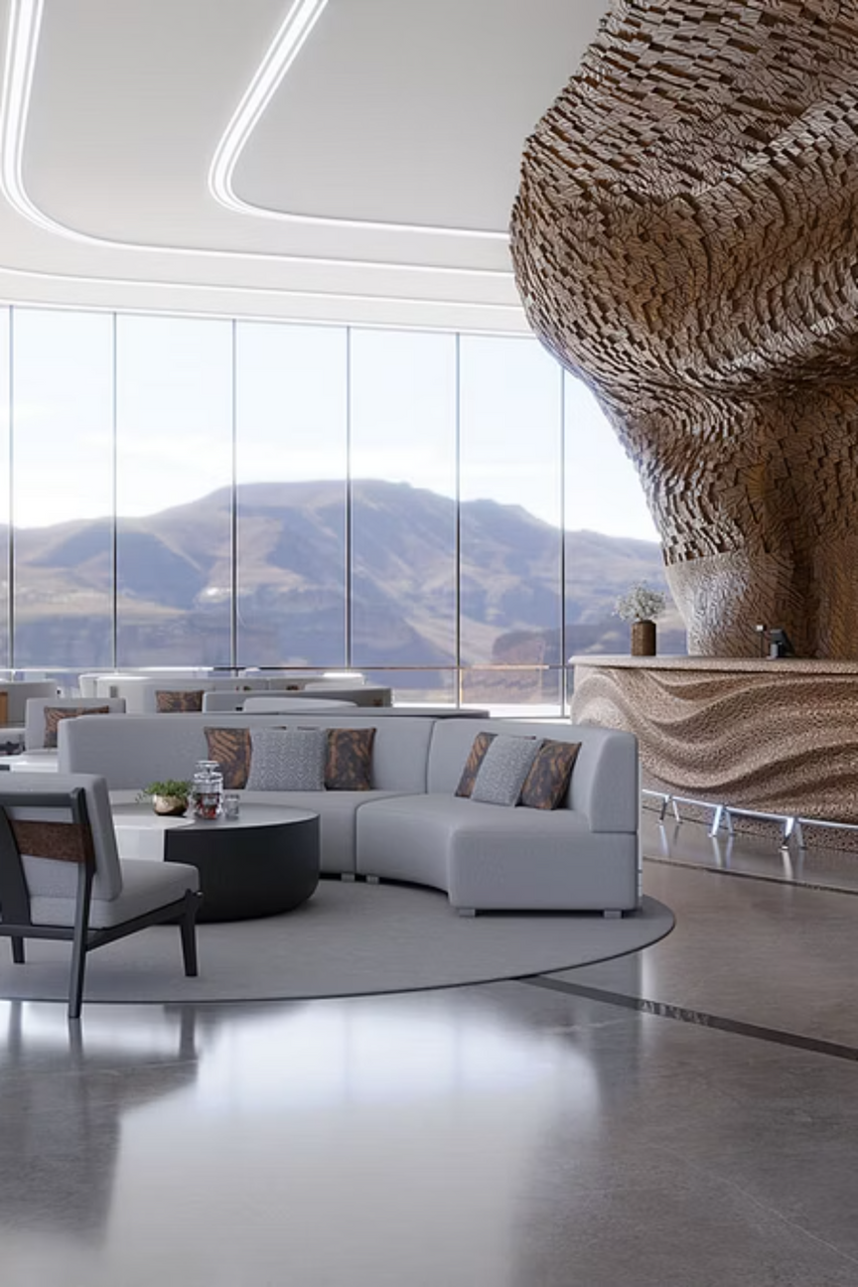

Hotel Guest Sentiment Analyzer
Automated Review Classification using Natural Language Processing
An automated solution leveraging Python and NLP to transform raw guest feedback into actionable operational insights.
Notes:
1

Slide 2
Meet the Project Team
1. P. Rajesh Babu – AP23110011369
2. S. Nagarjuna – AP23110011370
3. L. Jashwanth – AP23110011398
4. U. Naveen – AP23110011502
5. K. Sainath – AP23110011646
Notes:
2

Slide 3

The Challenge: Manual Analysis at Scale
Volume Overload
Hotels receive hundreds of guest reviews daily across multiple platforms, making manual reading impossible.
Subjectivity Bias
Manual interpretation varies by employee, leading to inconsistent data tagging.
Slow Reaction Time
Critical negative feedback gets buried, preventing timely service recovery.
Pattern Blindness
It is difficult for humans to spot aggregate trends across thousands of data points quickly.
Notes:
3

Slide 4




Project Objectives
Our system is designed to automate the feedback loop and provide real-time clarity.
Automated Analysis
Accurate Classification
Develop a system to instantly process reviews without human intervention.
Classify sentiment as Positive, Negative, or Neutral with high precision.
Real-Time Insights
Batch Processing
Provide immediate visual feedback via a web interface for operations teams.
Support bulk analysis of historical data via CSV file uploads.
Notes:
4

Slide 5
System Architecture: The 3-Tier Model
A robust architecture ensures scalability and separation of concerns.
Frontend Layer (Web Interface)
Backend Layer (Flask + NLP)
Database Layer (SQLite)
Responsive HTML/CSS/Bootstrap interface for user interaction and data visualization.
Stores processed reviews, sentiment scores, and timestamp data for historical tracking.
Python server handles routing, text preprocessing, and TextBlob sentiment calculations.
Notes:
5

Slide 6





Sentiment Analysis Workflow
From raw text to actionable insight: the journey of a single review.
User Input
Raw text entry or CSV upload
Preprocessing
Lowercasing, Tokenization, & Cleaning
Analysis
TextBlob Polarity Calculation
Classification
Threshold Logic Applied
Visualization
Update Dashboard Results
Classification Logic
Positive (Green): Polarity > 0.45
Neutral (Orange): -0.45 ≤ Polarity ≤ 0.45
Negative (Red): Polarity < -0.45
Notes:
6

Slide 7

Dataset & Preprocessing Methodology
Data Source
01
We utilize the hotel_reviews_dataset.csv, a comprehensive collection of real-world guest feedback. This dataset includes critical features such as the raw review text, hotel names, and associated ratings.
Standardization
Converting all text to lowercase to ensure consistency.
02
Cleaning
Removal of punctuation and non-alphanumeric characters.
03
Tokenization
Splitting sentences into individual word components.
04
Stopword Removal
Filtering out noise words like "the", "a", and "an".
Notes:
7

Slide 8




Feature Extraction & Examples
We utilize Polarity (-1 to +1) and Subjectivity (0 to 1) to determine sentiment.
Review Text
Polarity
Subj.
Result
"The staff was incredibly helpful and the room was spotless!"
0.85
0.90
Positive
"The location is okay, but the breakfast was just average."
0.05
0.40
Neutral
"Terrible service. Dirty towels and noisy AC. Avoid!"
-0.70
0.80
Negative
Negative
Positive
-1 Red example: "Noisy, rude staff, dirty room."
+1 Green example: "Staff helpful and room spotless!"
Neutral
0 Orange example: "Location is okay, service acceptable."
Notes:
8

Slide 9








Technology Stack
The core technologies powering our application.
Backend & Data
Frontend & Tools
Python 3.11
HTML5 & CSS3
Core logic
Structure & Style
Flask
Bootstrap 5
Web Framework
Responsive UI
SQLite
Chart.js
Database Management
Visualizations
TextBlob
Flask-SQLAlchemy
NLP Library
ORM Operations
Notes:
9

Slide 10
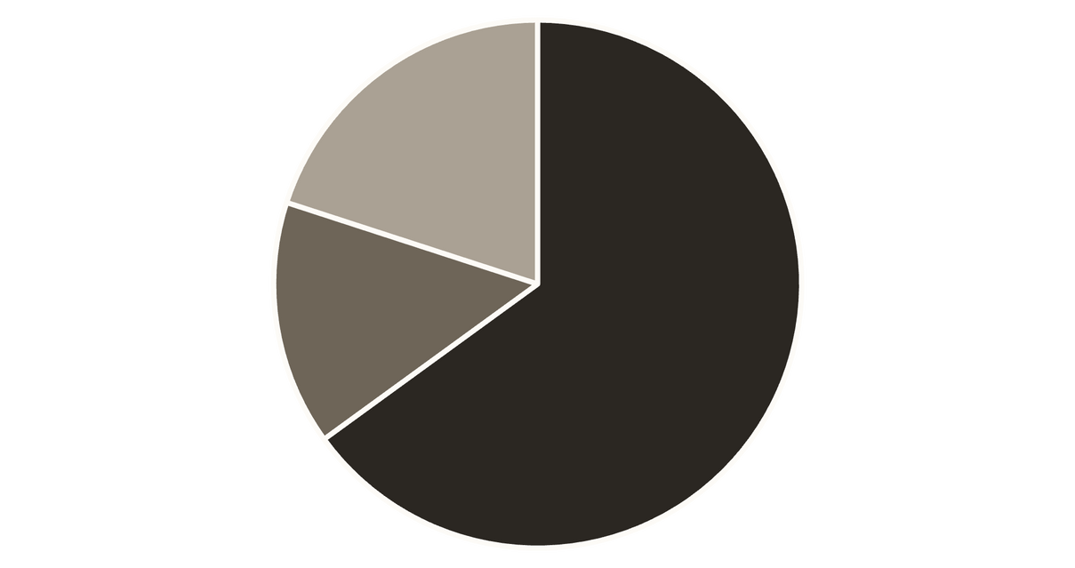
Results & Future Scope
Deep Learning
1
Transition to LSTM/BERT models for higher accuracy.
Live API
2
Integration with Tripadvisor/Google APIs for live fetching.
Mobile App
Positive
Negative
Neutral
Initial testing on the sample dataset reveals a skew toward positive guest experiences.
3
Development of a manager-facing mobile application.
Notes:
10

